Slide 1
5.1:Graph Theory Graph Representation

Slide 2
Graph Representations
In graph theory, a graph representation is a technique to store graph into the memory of computer.
To represent a graph, we just need the set of vertices, and for each vertex the neighbors of the vertex (vertices which is directly connected to it by an edge).
There are different ways to represent a graph:
Adjacency Matrix
Incidence Matrix
Adjacency List

Slide 3
Adjacency Matrix
Adjacency matrix is a sequential representation.
It is used to represent which nodes are adjacent to each other. i.e. is there any edge connecting nodes to a graph.
In this representation, we have to construct a nXn matrix A.
The adjacency matrix of G with respect to given ordered list of vertices is a n*n matrix denoted by A(G)=(a_{ij})_{n*n} such that
a_{ij} = 0 if there is no edge between the vertices v_{i}
1 if there is edge between the vertices v_{i}
K if there are K (K>=2) edges between the vertices v_{i}

Slide 4
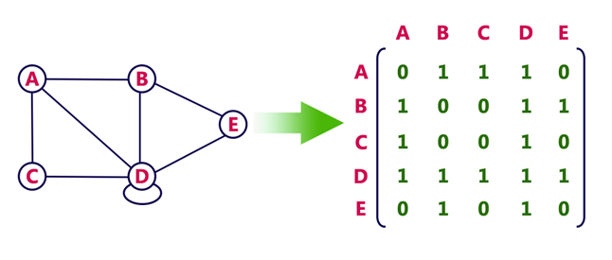
Example
Consider the following undirected graph representation:

Slide 5
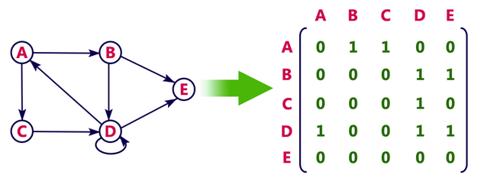
Example: For Directed graph

Slide 6
Pros: Representation is easier to implement and follow.
Cons: It takes a lot of space and time to visit all the neighbors of a vertex, we have to traverse all the vertices in the graph, which takes quite some time.

Slide 7
Incidence Matrix
In Incidence matrix representation, graph can be represented using a matrix of size:
Total number of vertices by total number of edges.
It means if a graph has 4 vertices and 6 edges, then it can be represented using a matrix
of 4X6 class. In this matrix, columns represent edges and rows represent vertices.
Let G be a graph with vertices v₁, v₂,…….,v_{m} and edes e₁,e₂,…….,e_{n} . The incidence matrix
I(G) of graph G is a m*n matrix with I(G)= (m_{ij})_{m*n} where
m_{ij} ^{= 1 if ej is incident with vi}
0 if ej is not incident with vi
^{2 if vi is has loop}

Slide 8
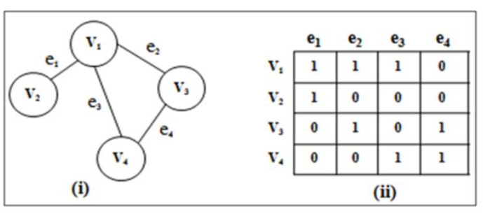
Example

Slide 9
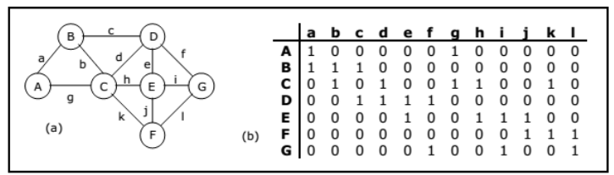
Example

Slide 10
Incidence Matrix: For directed graph
This matrix is filled with either 0 or 1 or -1. Where,
0 is used to represent row edge which is not connected to column vertex.
1 is used to represent row edge which is connected as outgoing edge to column vertex.
-1 is used to represent row edge which is connected as incoming edge to column vertex.

Slide 11
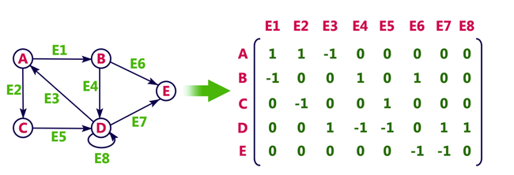
Example

Slide 12
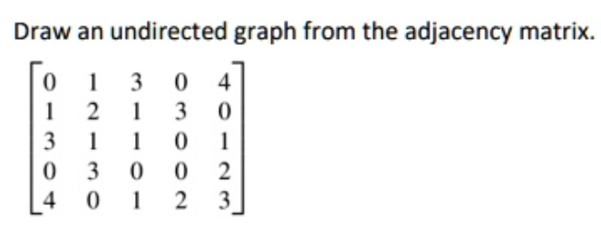
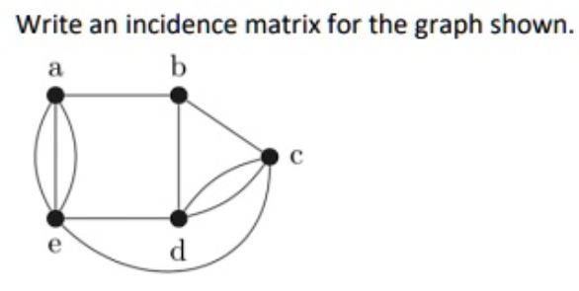
Questions

Slide 13
Adjacency List
Adjacency list is a linked representation.
In this representation, for each vertex in the graph, we maintain the list of its neighbors.
It means, every vertex of the graph contains list of its adjacent vertices.
We have an array of vertices which is indexed by the vertex number and for each vertex v, the corresponding array element points to a singly linked list of neighbors of v.

Slide 14
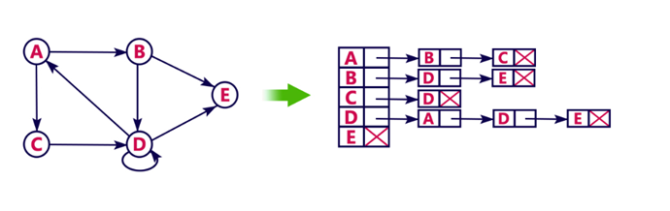
Example

Slide 15
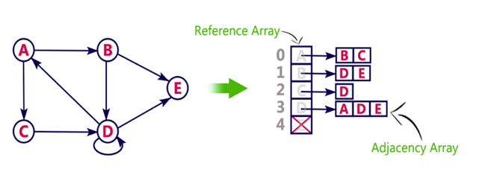
We can also implement this representation using array as follows:

Slide 16
Pros:
Adjacency list saves lot of space.
We can easily insert or delete as we use linked list.
Such kind of representation is easy to follow and clearly shows the adjacent nodes of node.
Cons:
slower

Slide 17
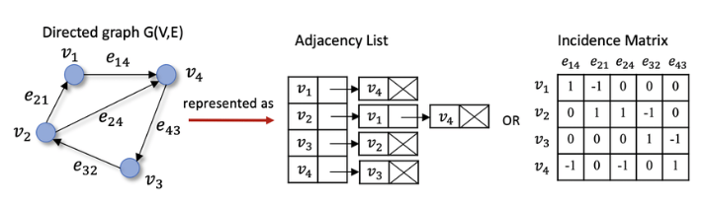
Example

Slide 18
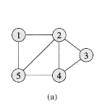
Question: Write adjacency matrix, incidence matrix and Adjacency list

Slide 19
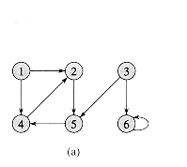
Question: Write adjacency matrix, incidence matrix and Adjacency list

